Slide 1
FOURIER ANALYSIS OF NUMERICAL INTEGRATION IN MONTE CARLO RENDERING
Kartic Subr Gurprit Singh Wojciech Jarosz
Heriot Watt University Dartmouth College Dartmouth College

Slide 2
This course …

Slide 3
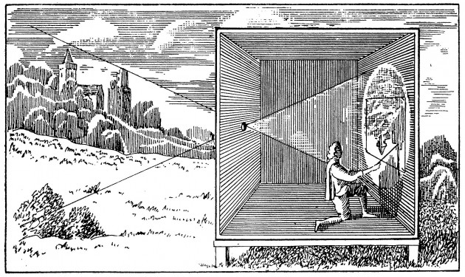
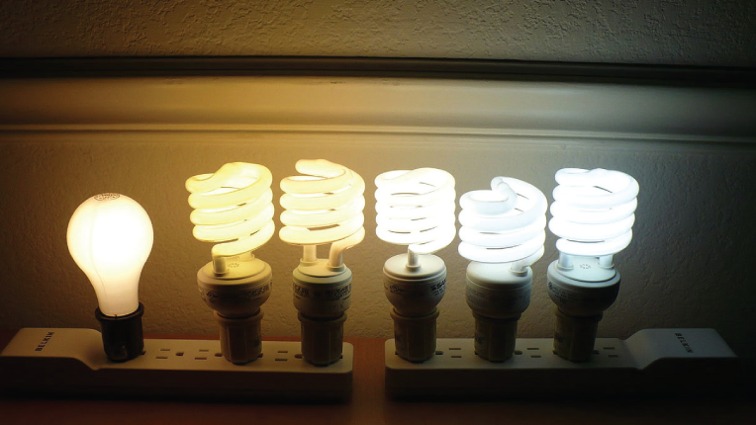
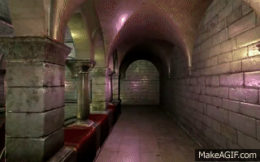
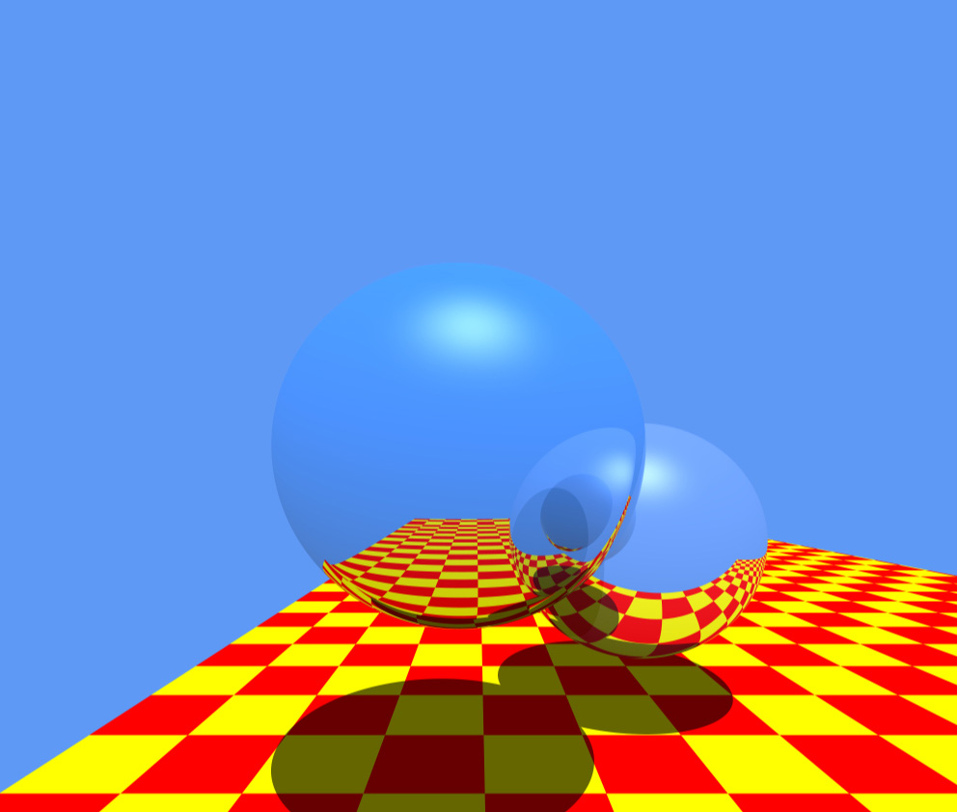
Rendering = geometry + radiometry
geometry/projection
for pin-hole model known since 400BC
radiometrically accurate simulation
is important for photorealism
OpenGL
Raytracing
[Stachowiak 2010]
[Whitted 1980]
camera obscura
[photo credit: videomaker.com June 2015]

Slide 4
Rendering = geometry + radiometry
geometry/projection
for pin-hole model known since 400BC
radiometrically accurate simulation
is important for photorealism
OpenGL
Raytracing
[Stachowiak 2010]
[Whitted 1980]
[photo credit: videomaker.com June 2015]

Slide 5
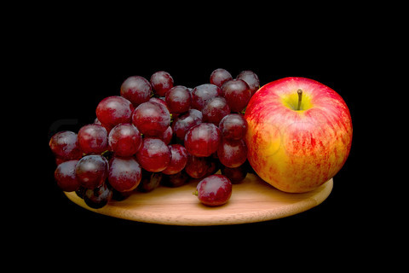
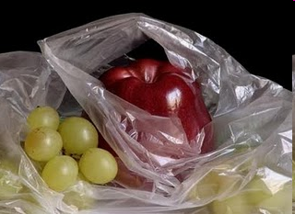

Radiometric fidelity improves photorealism
photograph
manually painted
computer generated
Colourbox.com
Pedro Campos

Slide 6

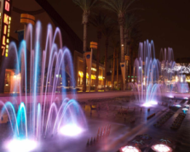
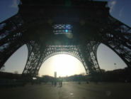


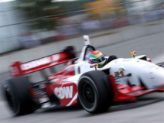
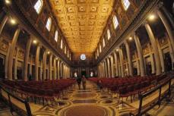
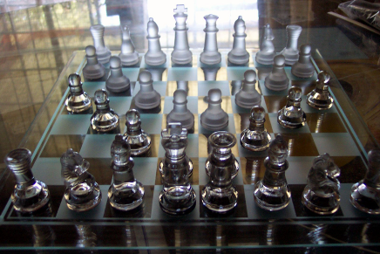
Simulating the physics of light is challenging
defocus
exposure time
lenses
light, media
materials

Slide 7
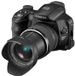
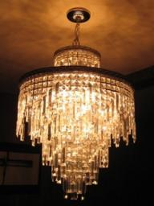
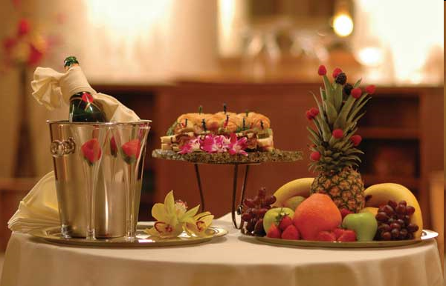
Light transport
virtual
light emitter
virtual
camera
Image ?
virtual scene: geometry + materials
estimate incident radiance at all pixels
on the virtual sensor
exitant radiance
W
m² Sr

Slide 8






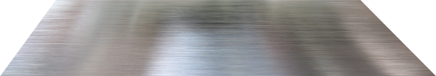

Each reflection is modelled by an integration
radiance:

Slide 9
Each reflection is modelled by an integration
radiance:

Slide 10
Each reflection is modelled by an integration
radiance:

Slide 11
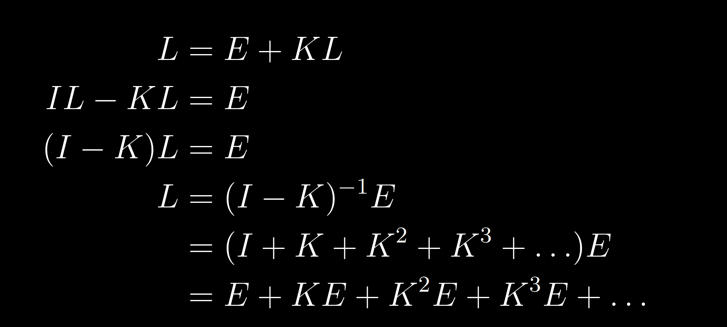
Light transport: recursive integral equation
radiance
emitted radiance
integral operator
The Rendering equation [Kajiya 86]
Light Transport Operators [Arvo 94]

Slide 12
L is a sum of high-dimensional integrals
radiance
integral operator
emitted radiance
One bounce
Three bounces

Slide 13
Reconstruction and integration in rendering

Slide 14
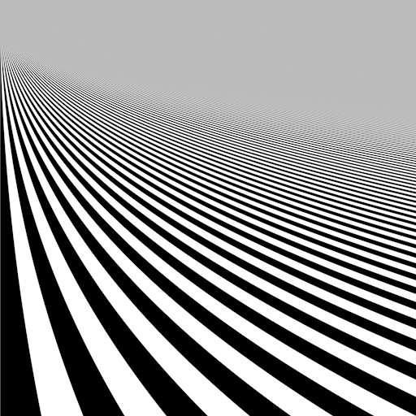
Reconstruction: estimate image samples
ground truth (high-res) image
reconstruct on (low-res) pixel grid
Y
Y
X
X

Slide 15
Naïve method: sample image at grid locations
ground truth (high-res) image
reconstruct on (low-res) pixel grid
Y
Y
sampling
copy
X
X

Slide 16
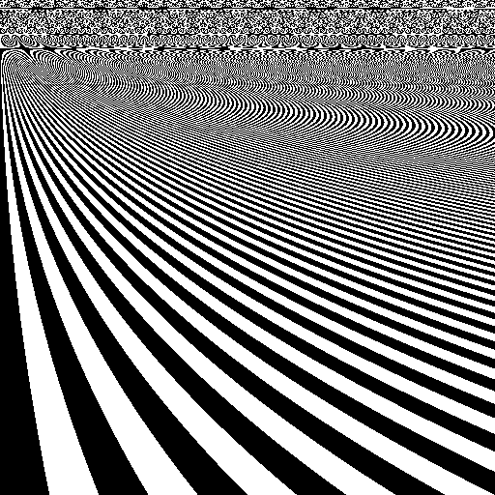
Naïve method: when sampling is increased
ground truth (high-res) image
reconstruct on (low-res) pixel grid
aliasing
Y
Y
X
X

Slide 17
Antialiasing: assuming `square’ pixels
Y
Y
multi-sampling
average
X
X

Slide 18
Antialiasing is costly due to multi-sampling
Y
Y
X
X

Slide 19
Antialiasing using general reconstruction filter
Y
Y
multi-sampling
weighted
average
X
X

Slide 20

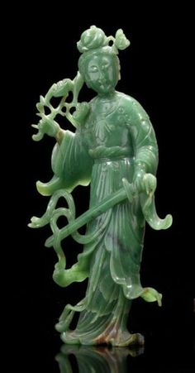
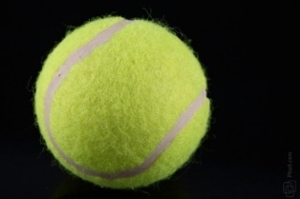
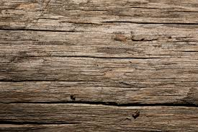
Rendering: Reconstructing integrals
path 1
Y
path 2
multi-sampling
for reconstruction
multi-path sampling
for integration
estimate per sampled pixel
path 3
X

Slide 21
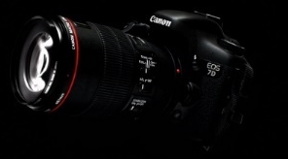
Function-space view: Sampling in path space
each sample represents a path
and has an associated radiance value
light
light paths
camera
n-dimensional path space
Notes:
3 trillion paths and 16D

Slide 22
Sample locations shown in path-pixel space
n-dimensional path space
pixels on sensor
Notes:
Figure from SIGG course notes

Slide 23
Rendering: integration followed by reconstruction
path-space integration
(projection)
n-dimensional path space
pixel value (radiance)
reconstruction using
integrated radiance
pixels on sensor
pixels on sensor
Notes:
Figure from SIGG course notes

Slide 24
Local variation is useful for adaptive sampling
path-space integration
(projection)
pixel value (radiance)
n-dimensional path space
integrated radiance
local variation/
anisotropy?
use in regression/reconstruction
pixels on sensor
pixels on sensor
Notes:
Figure from SIGG course notes

Slide 25
Integration

Slide 26
Fourier analysis
Eigenfunction of the differential operator
some history of the Fourier transform: Fourier, Cauchy, etc.

Slide 27
Projection onto a basis
Complex plane
Across Frequencies

Slide 28
Consequence of Fourier basis
Notion of frequency
Magnitude and phase

Slide 29
Variations
Continuous FT
Discrete Fourier transform
Periodic functions
Fourier series
Fast Fourier Transform

Slide 30
DC is integral of function
Segway into integration

Slide 31
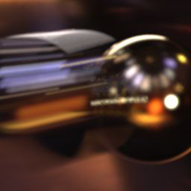

Light transport = integration
Shiny ball in motion
Shiny ball, out of focus
…
…
pixel
multi-dim integral
Integrand: radiance (W m⁻² Sr⁻¹)
…
Domain: pixel area x shutter time x aperture area x 1st bounce x 2nd bounce

Slide 32


Abstracting away the application…
0
Notes:
So, we want to compute the integral of f(x) (shown in yellow). What if f(x) was discretized and stored in an array?
http://www.sciweavers.org/free-online-latex-equation-editor

Slide 33


the sampling function
integrand
sampled integrand
sampling function
multiply
Notes:
What I called the sampled integrand is simply the product of the function and the sampling function, in this case a regular grid, or a piece of the Dirac comb or Shah function.
http://www.sciweavers.org/free-online-latex-equation-editor

Slide 34
sampling func. decides integration quality
integrand
sampled function
sampling function
multiply
Notes:
It turns out, that this sampling function is vital in deciding the quality of numerical integration. There are two fundamental ways to improve this sampling function.

Slide 35
strategies to improve estimators
1. modify weights
2. modify locations
eg. quadrature rules
eg. importance sampling
Notes:
Also, the positions of samples may be modified. Either they could be sampled according to some distribution or they could be arranged with constraints (such as minimal distance ala Poisson disk sampling). Obviously, combinations of the two are possible. But which of these is more desirable? The machinery required to analyse the different methods is different.

Slide 36
abstract away strategy: Fourier domain
1. modify weights
2. modify locations
analyse sampling function in Fourier domain
eg. quadrature rules
Notes:
To abstract away these approaches, we analyse the estimators based on the signature of the sampling function in the Fourier domain. eg. This plot shows the amplitude (yellow) and phase (blue) of the sampling signal.

Slide 37
abstract away strategy: Fourier domain
1. modify weights
2. modify locations
sampling function in the Fourier domain
amplitude (sampling spectrum)
eg. quadrature rules
a. Distribution eg. importance sampling)
frequency
phase (sampling spectrum)
Notes:
To abstract away these approaches, we analyse the estimators based on the signature of the sampling function in the Fourier domain. eg. This plot shows the amplitude (yellow) and phase (blue) of the sampling signal.

Slide 38
stochastic sampling & instances of spectra
Instances of sampling functions
Instances of sampling spectra
Sampler
(Strategy 1)
draw
Fourier
transform
Notes:
Remember that each instance of samples from the sampler produces a different sampling spectrum. Now given the many instances of sampling spectra from two different sampling strategies …

Slide 39
assessing estimators using sampling spectra
Instances of sampling functions
Instances of sampling spectra
Sampler
(Strategy 1)
Which strategy is better? Metric?
Sampler
(Strategy 2)
Notes:
the question we address is how we can compare the strategies, for use in numerical integration. But what is the basis of comparison?

Slide 40
accuracy (bias) and precision (variance)
Estimator 2 has lower bias but higher variance
reference
frequency
Estimator 1
Estimator 2
estimated value (bins)
Notes:
Given two estimators, we can now compare their respective biases and variances. But can we do such comparisons predictively?

Slide 41


Variance and bias
predict as a function of sampling strategy and integrand
High variance
High bias
Notes:
So, we want to compute the integral of f(x) (shown in yellow). What if f(x) was discretized and stored in an array?
http://www.sciweavers.org/free-online-latex-equation-editor

Slide 42
Monte Carlo integration
Error
Bias
Variance
Convergence

Slide 43
Stochastic sampling function
Spectral profile
Periodogram as an estimate of the power spectral density
Expected sampling spectrum and variance of the sampling spectrum

Slide 44
How could FT be useful in rendering
return to the function space view
Show local variation. Motivate adaptive sampling using local variation
Cite papers
Ravi’s old SH stuff
Freq analysis of light transport, FDOF, Cov, Egan, Ravi’s visibility stuff…

Slide 45
Fourier analysis of MC: Intuition and summary
Show high level equation
talk about Fredo’s MSE stuff
bias and variance
convergence

